Slide 1
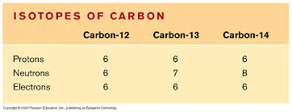
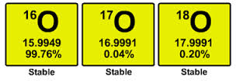
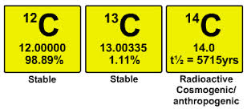
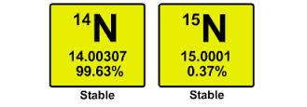
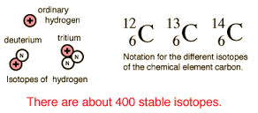
Example of isotope
Slide <number> of 25
General Chemistry: Chapter 2
Prentice-Hall © 2002

Slide 2

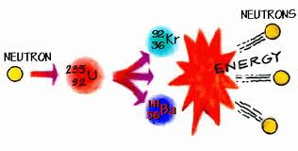
Problem
The isotope of uranium used to generate nuclear power is
.
How many protons, neutrons, and electrons does an atom of
have?
Slide <number> of 25
General Chemistry: Chapter 2
Prentice-Hall © 2002

Slide 3
Problem
The isotope of uranium used to generate nuclear power is
.
How many protons, neutrons, and electrons does an atom of
have?
Solve:
An atom of
has 92 protons, 92 electrons, and
235 – 92 = 143 neutrons.
Slide <number> of 25
General Chemistry: Chapter 2
Prentice-Hall © 2002

Slide 4
Molecule
A molecule is an aggregate of at least two atoms in a definite
arrangement held together by chemical forces (also called chemical bonds).
A molecule may contain atoms of the same element or atoms of two or
more elements joined in a fixed ratio.
Diatomic molecule:
Diatomic molecule contains only two atoms.
Example: H₂, N₂, O₂, Br₂, HCl, CO
Polyatomic molecule: Molecules containing more than two atoms are
called polyatomic molecules.
Example: water (H₂O) and ammonia (NH₃) are polyatomic molecules.
Slide <number> of 25
General Chemistry: Chapter 2
Prentice-Hall © 2002

Slide 5
Ion
An ion is an atom or a group of atoms that has a net positive or negative
charge.
The loss of one or more electrons from a neutral atom results in a cation,
an ion with a net positive charge.
For example: sodium atom (Na) can readily lose an electron to become a
sodium cation, which is represented by Na+.
On the other hand, an anion is an ion whose net charge is negative due
to an increase in the number of electrons. A chlorine atom (Cl), can gain
an electron to become the chloride ion Cl-.
Slide <number> of 25
General Chemistry: Chapter 2
Prentice-Hall © 2002

Slide 6


Ions
Sodium chloride (NaCl), ordinary table salt, is called an ionic compound
because it is formed from cations and anions.
Slide <number> of 25
General Chemistry: Chapter 2
Prentice-Hall © 2002

Slide 7

Do You Understand Ions?
27
Al
3⁺
How many protons and electrons are in
?
13
13 protons, 10 (13 – 3) electrons
How many protons and electrons are in
78
Se
2-
?
34
34 protons, 36 (34 + 2) electrons

Slide 8
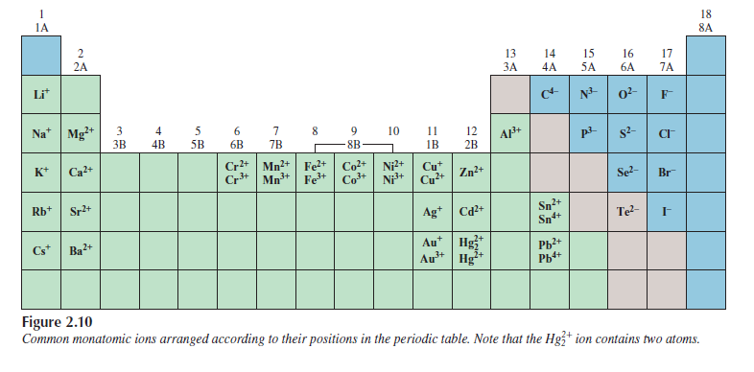
Ions
Slide <number> of 25
General Chemistry: Chapter 2
Prentice-Hall © 2002

Slide 9
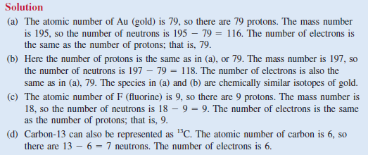
Problem
Slide <number> of 25
General Chemistry: Chapter 2
Prentice-Hall © 2002

Slide 10
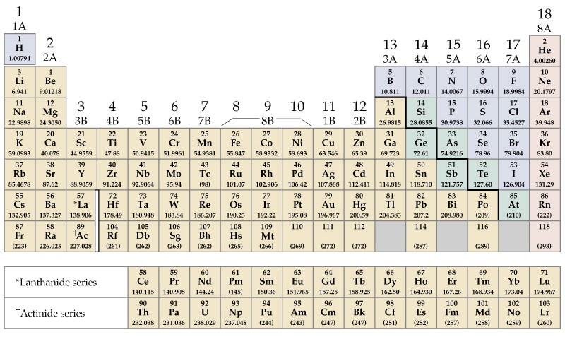
The Periodic table
Alkali Metals
Noble Gases
Alkaline Earths
Main Group
Halogens
Transition Metals
Main Group
Lanthanides and Actinides
Slide <number> of 25
General Chemistry: Chapter 2
Prentice-Hall © 2002

Slide 11
Periodic Table
Note: Under normal conditions, elements in Black are solids (K, S); elements in Blue are liquids (Hg & Br₂); elements in Red are gases (H₂, F₂, Ar).
IMPORTANT Memorize: Hydrogen, Nitrogen, Oxygen, Fluorine, Chlorine, Bromine & Iodine normally exist as diatomic molecules, & these molecules have the same names as the atoms:
H₂ N₂ O₂ F₂ Cl₂ Br₂ I₂
hydrogen, nitrogen, oxygen, fluorine, chlorine, bromine, iodine

Slide 12
Mole (abbreviated, mol)
One mole of any substance is the amount whose mass in grams –
its molar mass- is numerically equal to its molecular or formula
weight.
One mole of ethylene has a mass of 28.0 g
One mole of HCl has a mass of 36.5 g
Example:
Mole:
The amount of a substance whose mass in grams
is numerically equal to its molecular or formula
weight.
Slide <number> of 25
General Chemistry: Chapter 2
Prentice-Hall © 2002

Slide 13
Mole
Moles tell us how many molecules of each reactant are needed
Grams tell us how much mass of each reactant is needed
Moles
Numbers of molecules
Grams
Mass
Slide <number> of 25
General Chemistry: Chapter 2
Prentice-Hall © 2002

Slide 14
Problem
How many moles of sucrose are in a tablespoon of sugar that
contains 2.85 g? (Molar mass of sucrose, C₁₂H₂₂O₁₁, is 342)
Slide <number> of 25
General Chemistry: Chapter 2
Prentice-Hall © 2002

Slide 15
Problem
How many moles of sucrose are in a tablespoon of sugar that
contains 2.85 g? (Molar mass of sucrose, C₁₂H₂₂O₁₁, is 342)
Solve:
1 mol sucrose
2.85 g sucrose x
= 0.00833 mol sucrose
342 g sucrose
= 8.33 x 10⁻³ mol sucrose
Note: As molecular mass of sucrose is 342 amu, 1 mol of sucrose has
a mass of 342 g.
Slide <number> of 25
General Chemistry: Chapter 2
Prentice-Hall © 2002

Slide 16
Problem
Solve:
Note: As molecular mass of sucrose is 342 amu, 1 mol of sucrose has
a mass of 342 g.
1 mol sucrose
2.85 g sucrose x
= 0.00833 mol sucrose
342 g sucrose
= 8.33 x 10⁻³ mol sucrose
Slide <number> of 25
General Chemistry: Chapter 2
Prentice-Hall © 2002

Slide 17
Problem
How many grams are in 0.0626 mol of NaHCO₃, the main ingredient
In Alka-Seltzer (antacid) tablets?
Slide <number> of 25
General Chemistry: Chapter 2
Prentice-Hall © 2002

Slide 18
Problem
How many grams are in 0.0626 mol of NaHCO₃, the main ingredient
In Alka-Seltzer (antacid) tablets?
Solve:
Molar mass of NaHCO₃ = 84.0 g/mol
We know,
Mass
Mole =
Molar mass
84.0 g NaHCO₃
0.0626 mol NaHCO₃ x
=
5.26 g NaHCO₃
1 mol NaHCO₃
Slide <number> of 25
General Chemistry: Chapter 2
Prentice-Hall © 2002

Slide 19
Avogadro’s number (N_{A})
How many molecules are there in a mole?
Experiments show that one mole of any substance contains 6.022 x 10²³
formula units, a value called Avogadro’s number (NA).
Avogadro’s number of formula units of any substance – that is,
one mole- has a mass in grams numerically equal to the molecular weight
of the substance.
1 mol HCl = 6.022 x 10²³ HCl molecules = 36.5 g HCl
1 mol C₂H₄ = 6.022 x 10²³ C₂H₄ molecules = 28.0 g C₂H₄
Slide <number> of 25
General Chemistry: Chapter 2
Prentice-Hall © 2002

Slide 20
Problem
Sulfur (S) is a nonmetallic element that is present in coal. When coal
is burned, sulfur is converted to SO₂ and eventually to sulfuric acid
that gives rise to acid rain phenomenon.
How many atoms are in 16.3 g of S?
Slide <number> of 25
General Chemistry: Chapter 2
Prentice-Hall © 2002

Slide 21
Problem
Sulfur (S) is a nonmetallic element that is present in coal. When coal
Is burned, sulfur is converted to SO₂ and eventually to sulfuric acid
That gives rise to acid rain phenomenon.
How many atoms are in 16.3 g of S?
1 mol S = 32.07 g S
Solve:
We also know, 1 mol S = 6.022 x 10²³ particles (atom)
6.022 x 10²³ atom
1 mol S
16.3 g S x
x
=
3.06 x 10²³
S atoms
32.07 g S
1 mol S
Slide <number> of 25
General Chemistry: Chapter 2
Prentice-Hall © 2002

Slide 22
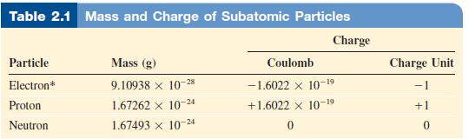
Mass and charge of subatomic particles
Slide <number> of 25
General Chemistry: Chapter 2
Prentice-Hall © 2002

Slide 23
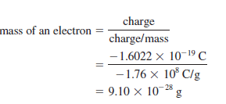
Calculation of mass of electron
R. A. Millikan, an American physicist, found the
charge of an electron to be
Slide <number> of 25
General Chemistry: Chapter 2
Prentice-Hall © 2002

